Slide 1

Functional Programming
C#
JS
code
.OrderBy(c => c.LevelOfAwesome)
.Select(c => c.Type)
.First()
.Equals("Functional")
For the everyman

Slide 2
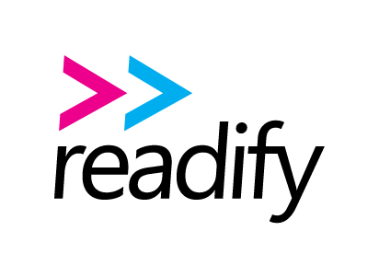

Who dat?
Daniel Chambers
Senior Consultant at Readify
@danielchmbrs
Notes:
My name is Daniel Chambers and I work as a Senior Consultant for Readify. My twitter handle is up on the slide, so if you have questions or feedback, please feel free to tweet it to me.

Slide 3





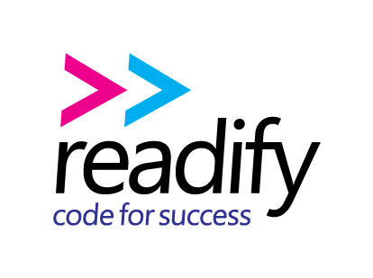








Sponsors
Notes:
DDD Melbourne wouldn’t be possible without our sponsors, so please say thanks to them on Twitter or if you see them around.

Slide 4
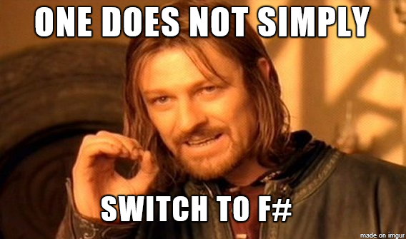

Why this talk?
Notes:
Some of you may remember that last year I gave a talk on F# at DDD Melbourne. I also gave it at a few companies and user groups. I love F#; it’s my favourite language, and I think more people should use it to write clean and composable code.
So you might be wondering why I’m doing a talk on functional programming in C# and JavaScript, instead of in F#. What I realised when I did my talk last year is that, whilst people love the look of F#, most people can’t just jump ship off what they’re coding in right now; this means C# and JavaScript. We’ve got years of investment in these code bases, and we can’t just chuck all of that away. I think Boromir says it best; one does not simply switch to F#.

Slide 5


Why this talk?
Notes:
Some people are scared off by functional programming, because it can be quite different from the typical imperative-style code that most people write in their day jobs.
But what most people don’t realise is that they’ve doing little bits of functional programming for a while now because functional programming constructs have been stealthily added to C# and JavaScript for years. However, the problem is most people don’t use these features to the fullest extent that they could, and so when they see code that written in full blown functional programming style, they’re all like WTF.
So the aim of this talk is to show you how you can use the functional features of your language, together with functional libraries so that you can get some functional programming benefits now, in your day job. Then, once you’re used to this first level of functional programming, you’ll be naturally attracted to full blown functional programming languages like F# and techniques.

Slide 6

History
Unstructured Programming
Goal: to make developers cry
Structured Programming
Goal: to make flow of control clear
goto aCompleteMess;
for (int i = 0; i < 10; i++)
{ … }
while (condition)
{ … }
void Subroutine(int arg)
{ … }
Notes:
First, a little bit of history to put functional programming in context.
In the beginning… there was unstructured programming, which used the goto statement to allow the developer to control the flow of the program. This allowed us to write programs that were a total mess.
Structured programming was introduced to kill off the goto. We lifted the level of abstraction up a notch by formalising looping into constructs like for and while loops. Procedures and subroutines were added to split code out and make it more easily reusable. Structured programming was an attempt to make the flow of control clear. This was a big step up from unstructured programming because it made the code much more easy to reason about because of the common control structures.
Unfortunately, structured programming had a nasty flaw: global variables. Everyone here knows the pain of global variables and how code that uses them is extraordinarily hard to understand and reason about.

Slide 7
History
Object-Oriented Programming
Goal: to kill global variables by encapsulating state
Functional Programming
Goal: to kill off state
class Component
{
private State _state;
virtual void Work()
{ … }
}
people
.Where(p => p.Name.StartsWith("D"))
.SelectMany(p => p.Children)
.Select(c => c.Name);
Notes:
To solve this, object-oriented programming was created to kill off the global variable by providing language features to make it easy to encapsulate state. It did this by tying data and subroutines together into the concept of a class. It also made further steps towards code reuse by introducing inheritance and composition. Again, we lifted the level of abstraction up a notch with the aim to improve our ability to understand code and reason about it. This allowed the complexity of our software to jump up.
But as you probably know, there’s still issues with state management in OOP. While variables are local to classes, they are still variable and shared by everything in the class and possibly externally.
Functional programming takes it to the next level; its aim is to remove state altogether. State is variables whose values can change. We can remove state through judicious use of “pure functions”, which are functions that have no side effects and therefore always return the same output for the same input. This simplifies the code by eliminating moving parts, where the moving parts in your code are the variables.
Functional programming lifts the level of abstraction further by treating functions as values, which makes reusing code trivially easy. This allows for the implementation of libraries that act as domain specific languages, making it so you can focus on writing your business logic rather than control logic. An example of such a library is LINQ, the domain of LINQ is sequences of values.

Slide 8

What about functional-first languages?
Functional Programming
A style of programming where expressions are more important than statements
var result = a + b; //Expression
result += c; //Statement
Erik Meijer – LINQ & Rx
Notes:
So you’re probably wondering, “well don’t I need a functional programming language in order to do functional programming?” The answer is no!
Erik Meijer, of LINQ and Reactive Extensions (Rx) fame, defines functional programming as “a style of programming where expressions are more important than statements”. This is a key point in understanding practical functional programming. Expressions take input and deliver a result, and we combine expressions to express a wider program. Expressions don’t have a side effect; they return a value.
Statements are the antithesis of expressions and therefore functional programming; they have an implicit side effect against the global state and since we’re trying to eliminate state altogether, we need to get rid of statements and focus on expressions.
Functional programming languages make writing code solely in expressions easier by adding language features that help support this; and good news, some of those features have already been brought into the languages we use every day, such as C# and JavaScript.
Now let’s see how we can use our day to day languages to start doing a little bit of functional programming.

Slide 9

C# & LINQ
LINQ Name | Other FP Names
Select | Map
SelectMany | FlatMap, Collect
Where | Filter
Aggregate | Reduce, Fold
OrderBy | SortBy
ForEach | Iter
All | ForAll
Any | Exists
First | Find
Skip | Drop
LINQ is a set of higher order functions that let us deal with sequences of values using only expressions.
Notes:
C# 3 introduced lambda expressions, which makes functions as first class values easy. This introduced a wave of functional programming libraries to be added to .NET. LINQ is the best known library. LINQ is basically functional programming sneaked into the language by stealth. So guess what, you’re already doing a bit of functional programming!
LINQ is really a set of higher order functions (that is, functions that take other functions as parameters) that let us deal with sequences of values using only expressions and no statements. It lets us eliminate side effects and variables from our code when we deal with sequences; and it allows us to write simpler and more readable code.
LINQ is typical of functional programming; it raises the level of abstraction when dealing with a domain. In this case the domain is sequences, and the library allows us to reuse code that has already been written to deal with sequences. This means that we can write business logic that states what we want, instead of how to get what we want. This style of declarative programming is easy to do when programming functionally.
All functional programming languages will have a library like LINQ in them, however in order to sneak functional programming into .NET without scaring people, Microsoft used different function names to the functional norm. For example, in most functional programming libraries, Select is called Map. Aggregate is called Reduce or Fold. Any is called Exists.

Slide 10


FP is not scary – you’re doing it already!
Notes:
So hopefully you’re starting to realise that functional programming isn’t a totally weird beast that seems terrifying. You’re already using it with libraries like LINQ. However, what I see when I look at most C# and JavaScript code is that people are dabbling a little in functional programming, but they could improve their code even more by fully embracing it.

Slide 11

Code
Notes:
So let’s start looking at some practical code examples of how you could write your code more functionally to get rid of state, and make your code more readable and maintainable. This way you can start taking further steps down the functional programming path, and do so in your day job.

Slide 12
Conclusion
Functional Programming Program with expressions rather than statements.
Eliminate side effects State is the moving parts in your program. Remove it and simplify your code.
Use FP libraries to lift the level of abstraction LINQ, Rx, Lodash and many more.
Get started today! Functional Programming really is for the every(wo)man.
Twitter @danielchmbrs
Slides and Code
bit.ly/fp-for-everyman
Notes:
So, wrapping up, we’ve seen today how we can apply functional techniques to solve day to day problems. Functional programming features are present in modern imperative languages, and new versions of these languages tend to bring more functional features.
Functional techniques allow us to program at a higher level of abstraction. We program declaratively, stating what we want, rather than how to get what we want. We eliminate side effects and state from our code by programming with expressions rather than statements. This makes our code shorter, more readable, and more maintainable.
The code does look different, but not impossibly so. It doesn’t take long before you’ll find it natural to read. It’s a similar step forward that an unstructured programmer took when he abandoned the goto for the for loop.
Obviously there’s much more to functional programming than what we’ve seen here, but this is a great way to get started in your current codebase and reap real benefits. Once you get your toes wet, you’ll quickly realise that programming functionally isn’t so hard after all, and you’ll want more.
The slides and code for this are available on GitHub and if you have any questions, please ask, or you can catch me on Twitter.

